Slide 1
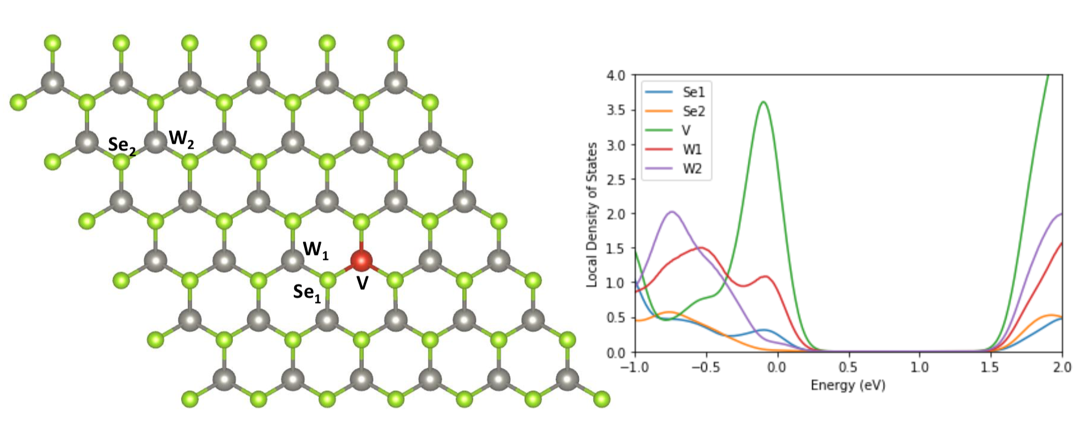
For DOS calculation
CB edge
Total DOS to see overall DOS feature
Smearing parameter change to see the enhancement of DOS near the CB edge
Please check the attached data from Dr. Loc. For the V doped case, you can find that there is a 2 extra bands near the valence band edge and conduction band edge. It might be due to the smearing parameter that we cannot see such a feature in the LDOS calculation.

Slide 2


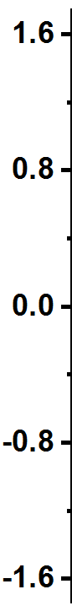
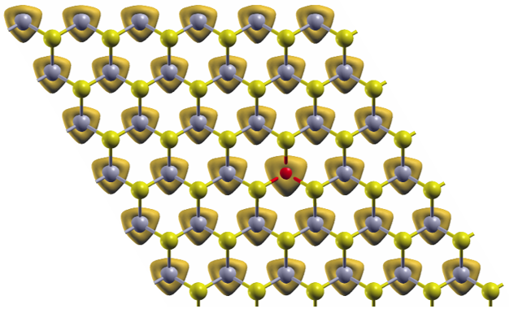
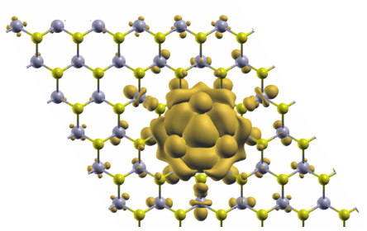
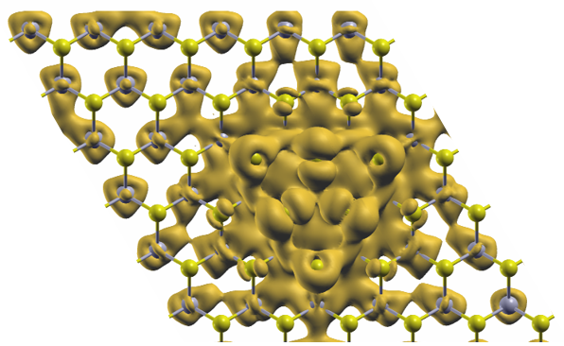
For DOS calculation
Figure 3: Localized and delocalized of doping states
a
V (3d) DOS
V (3d) DOS
b
Mn (3d) DOS
Mn (3d) DOS
Acceptor state
Strongly hybridized state
k path
k path
k path
k path
c
V-doped WSe₂
Spin-up valence band
Acceptor state
Strongly hybridized state

Slide 3
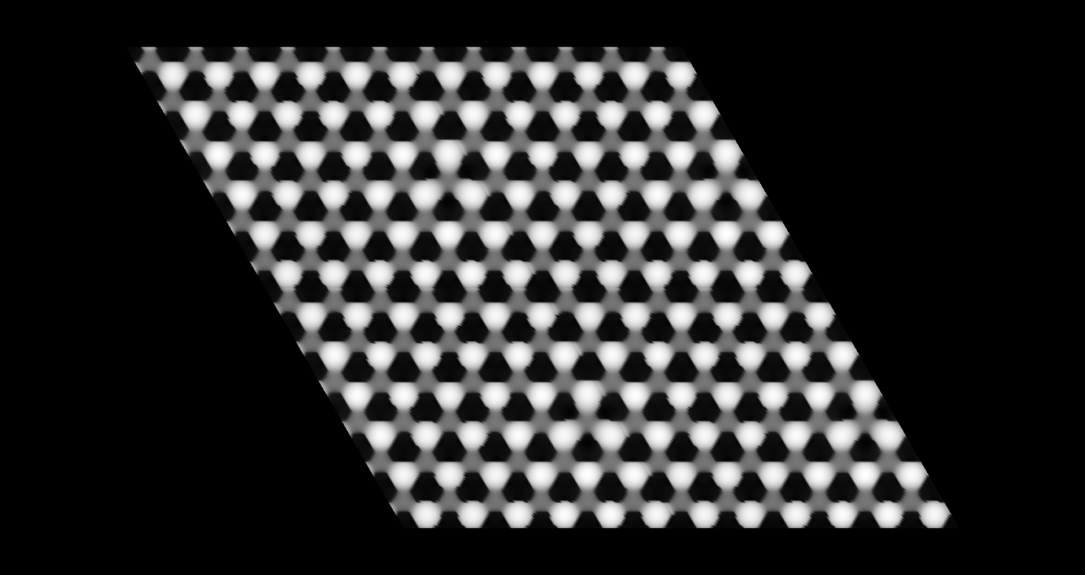
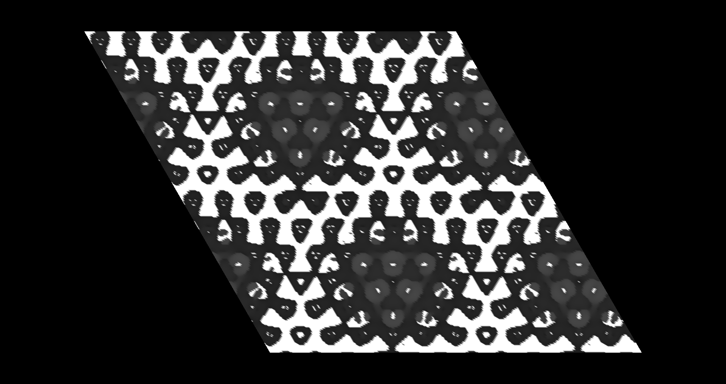
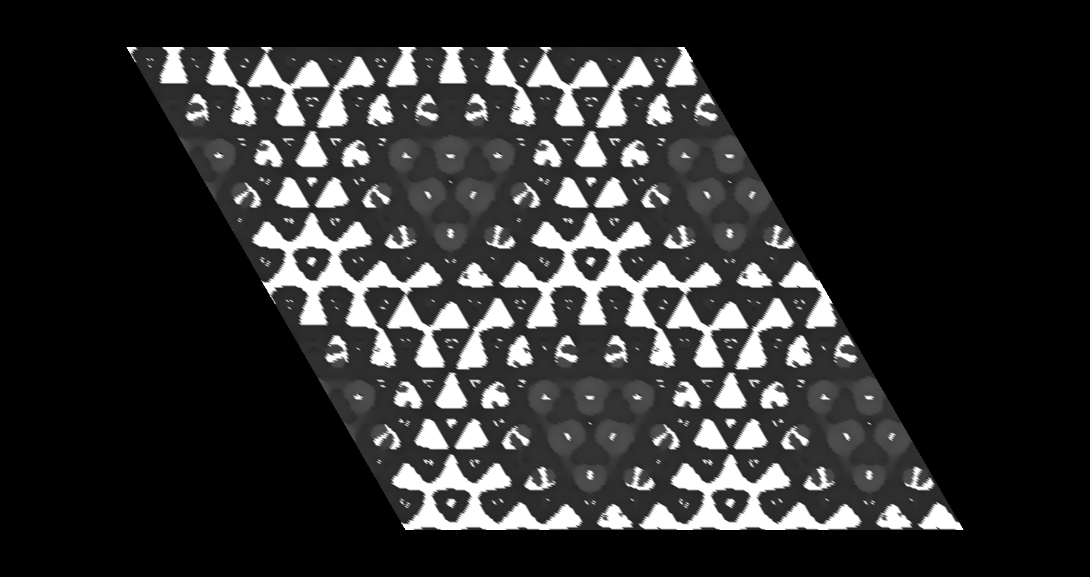
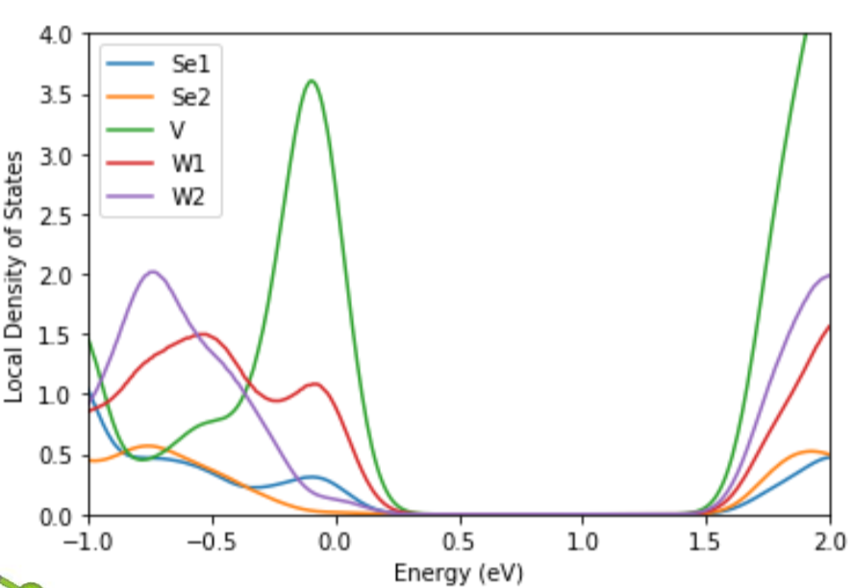
For STM simulation
V substitution only; -1V
V substitution only; 0V
V substitution only; 1V
Color + structure model
From those images it is hard to see the original structure and the position of dopant/defect. Could you change the color with a scale bar and superpose a structure model ?
Current isosurface value
Could you tune the isosurface value to see the feature more certainly?
* One more question: why the STM simulation shows a similar pattern as E=0eV even though there is no DOS at the E=1.0eV ?
E=-1.0 eV
E=0eV
E=1.0eV

Slide 4
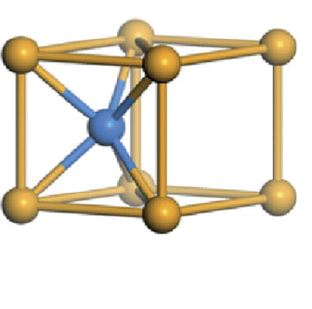
Structure models
Top Se
Top Se
Top Se
W
V
V
What we have done
Bottom Se
Bottom Se
Bottom Se
Graphene
Graphene
Graphene
Single Se vacancy
W -> V substitution
W -> V substitution
+ single Se vacancy
Se or O adsorption
Top Se
Top Se
What we need more
W
Bottom Se
Bottom Se
Graphene
Graphene
Single W vacancy
Chalcogen adsorption

